Slide 1
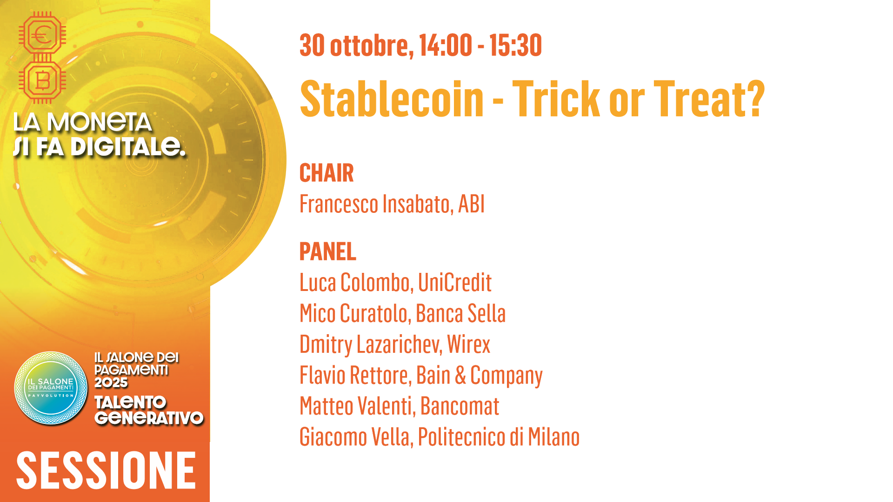

Slide 2



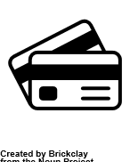
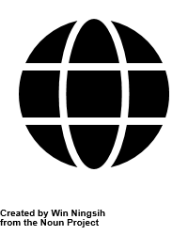








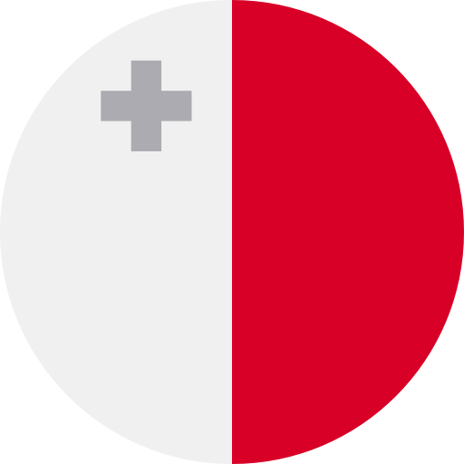
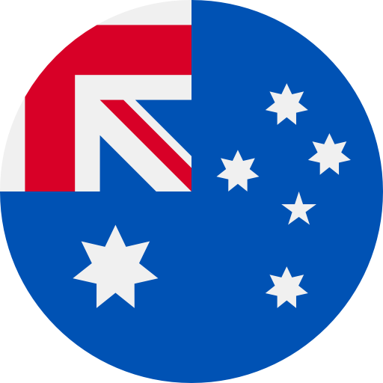
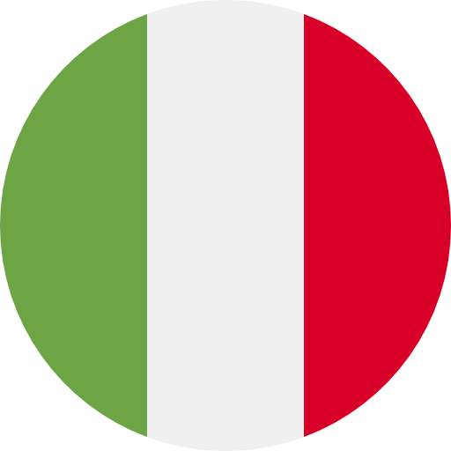
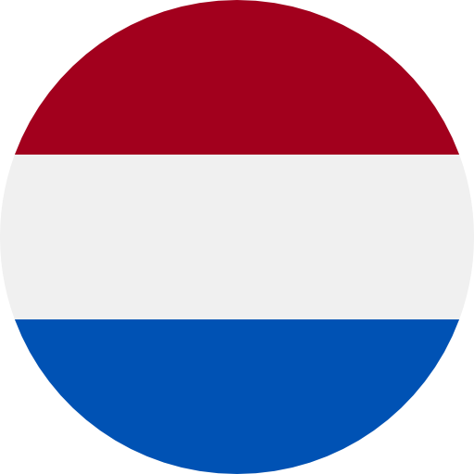
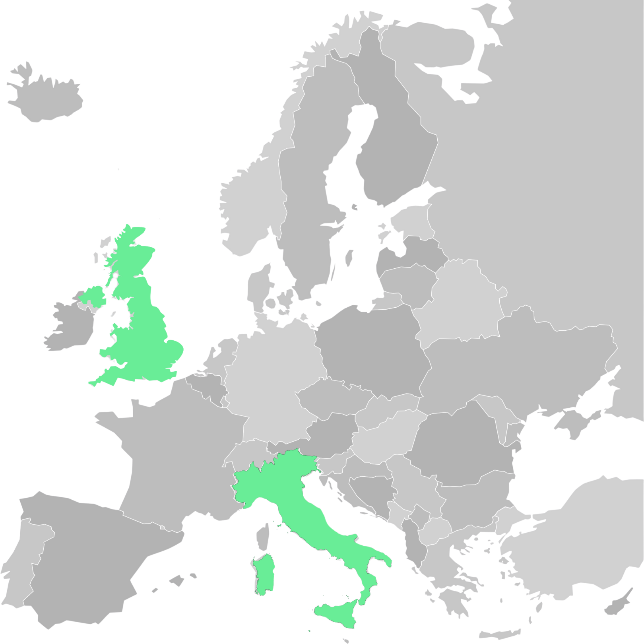
Our infrastructure: Built for Global Scalability and Compliance
Customer-facing products
and services
WIREX IN-HOUSE INFRASTRUCTURE
Crypto, Payments & Banking products
Wirex infrastructure
Innovated in-house
advanced layer
Wirex at a
Glance:
Powering Stablecoin
payments in Europe
Enablers
Core payment rails and partnerships that facilitate the movement of money
Local clearing
(ACH, SEPA, FPS)
Card issuing
OCT (Visa Direct, Money Send)
Digital Wallets
GLOBAL SET OF LICENSES
COMPLIANCE-FIRST
Global AML/KYC frameworks, Multi-jurisdictional regulatory oversight, Enterprise-grade risk & security systems
Foundational layer
Regulatory framework and credibility
  ✓ Founded 2014 - over 11 years of payments innovation
  ✓ 6+ million users in 130+ countries
  ✓ Top EU markets: UK, Italy, France, Germany
Stablecoin Capabilities
✓ Real-world stablecoin spending via card & wallet
✓ Wirex Pay platform links stablecoins to
Visa/Mastercard rails
Top 2 in Market:
ITALY
"At Wirex, we’ve spent over a decade bridging traditional finance and blockchain: making stablecoins usable, trusted, and real." - Dmitry Lazarichev, Co-Founder & CEO, Wirex

Slide 3

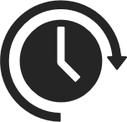

Stablecoins:
How stablecoins Enable Web3 Adoption
European Opportunity
Next Steps
The Bridge to Europe's Web3 Future
Provide price-stable digital value for daily use
Enable instant, low-cost settlements across borders
tokenized assets, and programmable money
Euro-backed stablecoins =<1% of global supply (vs. 70% USD-backed)
MiCAR offers path to close EU's euro-stablecoin gap
Wirex integrates euro-stablecoins into everyday payments
Enable bank-stablecoin interoperability
Support Euro-backed liquidity pools
“Stablecoins bring digital money closer to people. Faster, fairer, and built for everyday life.”
- Dmitry Lazarichev, Co-Founder & CEO, Wirex

Slide 4








Europe's Stablecoin Moment: From regulation to real-world adoption
Innovation
Key insights from Wirex's 2025 whitepaper:
Regulation
Adoption
Euro denominated stablecoins represent <1% of global market
MiCAR: EU= first region with comprehensive stablecoin regulation
Public-private collaboration critical for EU digital competitiveness
Competitiveness
"Europe’s MiCAR framework marks the first time regulation has actively created the conditions for innovation, not restrained it.”
- Wirex Whitepaper, 2025

